Slide 1
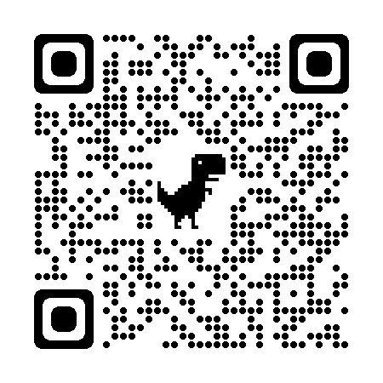
ENGAGE, NETWORK AND LEARN LOCALLY
SCTE is the industry’s trusted leader in professional development, certifications, and standards for those in engineering, field and network operations, construction, and more.
Join SCTE and our chapter for access to:
Hands-on learning experiences and professional development opportunities to expand your knowledge – and career and earning potential. And there’s an entire catalog of online learning at your fingertips.
Networking with industry leaders which can help you make your next move.
SCTE certification preparation and testing to show you’re the best of the best in the field.
Developing leadership skills by volunteering for our chapter. Share your expertise and make a difference while honing your skillset.
Join the network of more than 15,000 industry professionals and sign up for SCTE membership today. Your membership dues may be covered by your employer – just ask!
To join, scan the QR code and enter your info, including your company email. Be sure to select ________ Chapter on the My Chapter tab.
REGISTER FOR OUR NEXT CHAPTER EVENT
Date
Month 00, 0000
Time
00:00 P.M. – 00:00 P.M.
Location
City, State
Cost
$00
RSVP
www.sampleaddress.com
Contact 000.000.0000 Email@address.com

