Slide 1
Presentation Title Goes Here
LiveLearning WebinarsTM For Professional
SHAPING THE FUTURE OF CONNECTIVITY.
v
© 2022 Society of Cable Telecommunications Engineers, Inc. a subsidiary of CableLabs. | scte.org
Notes:
Cover Opt 1 (delete other options that are not being used)
Delete any content areas you do not need.

Slide 2
Presentation Title Goes Here
LiveLearning WebinarsTM For Professional
Presenter: First Last
Day, Month 00, 0000
00:00 pm – 00:00 pm ET (00:00 am PT)
SHAPING THE FUTURE OF CONNECTIVITY.
v
© 2022 Society of Cable Telecommunications Engineers, Inc. a subsidiary of CableLabs. | scte.org
Notes:
Cover Opt 1 (delete other options that are not being used)
Delete any content areas you do not need.

Slide 3
Presentation
Title Goes Here
LiveLearning WebinarsTM For Professional
SHAPING THE FUTURE OF CONNECTIVITY.
© 2022 Society of Cable Telecommunications Engineers, Inc. a subsidiary of CableLabs. | scte.org
Notes:
Cover Opt 1 (delete other options that are not being used)
Delete any content areas you do not need.

Slide 4
Presentation
Title Goes Here
LiveLearning WebinarsTM For Professional
Presenter: First Last
Day, Month 00, 0000
00:00 pm – 00:00 pm ET (00:00 am PT)
SHAPING THE FUTURE OF CONNECTIVITY.
© 2022 Society of Cable Telecommunications Engineers, Inc. a subsidiary of CableLabs. | scte.org
Notes:
Cover Opt 1 (delete other options that are not being used)
Delete any content areas you do not need.

Slide 5
Today’s Speaker
First, Last

Slide 6
Agenda

Slide 7
Poll Questions
Enter Question

Slide 8
Summary

Slide 9
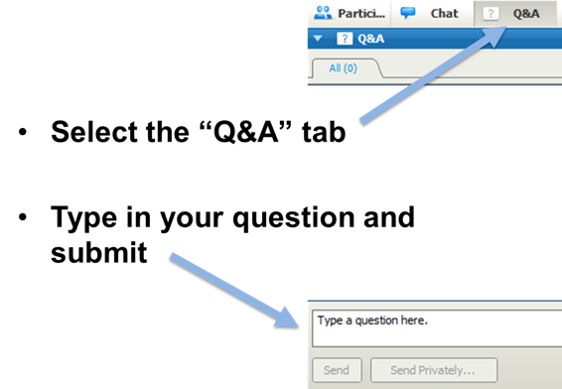
How To…
How To Ask a Question

Slide 45
Thank You!
LiveLearning WebinarsTM For Professional
SHAPING THE FUTURE OF CONNECTIVITY.
v
© 2022 Society of Cable Telecommunications Engineers, Inc. a subsidiary of CableLabs. | scte.org
Notes:
Cover Opt 1 (delete other options that are not being used)
Delete any content areas you do not need.

Slide 46
Thank You.
LiveLearning WebinarsTM For Professional
SHAPING THE FUTURE OF CONNECTIVITY.
© 2022 Society of Cable Telecommunications Engineers, Inc. a subsidiary of CableLabs. | scte.org
Notes:
Cover Opt 1 (delete other options that are not being used)
Delete any content areas you do not need.

Slide 47
Next Months Webinar
Webinar Title
Month 00, 0000 at 0:00pm (ET)
SCTE LiveLearning Webinars™ for Professionals is a series of live, interactive, web-based seminars that occur the third Thursday of every month.
Register for next month’s webinar, the 2022 webinar series or access previously recorded sessions at www.scte.org/LiveLearning. This educational series is a member benefit in partnership with LightReading.

